Slide 1
Data Analytics Phase
Submitted by
E R Shyama

Slide 2
Overview
A correlation matrix is used to evaluate the relationship between numerical variables and target variable in the dataset.
Bar plots are used to visualize mean of product weight among observations of each category(warehouse capacity, zone, regional zone and type of certificate of warehouse).
Count plots are used to visualize the count of records belonging to observations in each category(flood impacted, flood proof, electric_supply, and temp_reg_mach).
Z-test and Annova test has been used to find the impact of categorical variables on the target variable.
Z test has been used for categorical variables having 2 categories and Annova test has been used for categorical variables having more than 2 features.

Slide 3
Z test
Z test has been used for finding the impact by location type, warehouse owner type on target variable.
The null hypothesis is : This variable do not have an impact on target and
alternate hypothesis is : This variable have impact on target
The significane level(α) was choosen as 0.05.
From the test it was found that location type has an impact on target and warehouse owner type do not have any impact on the target.
p value was 0.0 for location type and 0.6 for warehouse owner type
In the milestone 1 the prediction was location type will affect the target variable and warehouse owner type will not affect the target variable

Slide 4
ANNOVA Test
ANNOVA test has been used for finding the impact by warehouse capacity size, zone, regional zone and warehouse certificate has on target variable.
The null hypothesis is : This variable do not have an impact on target and
alternate hypothesis is : This variable have impact on target
The significane level(α) was choosen as 0.05.
The p value for warehouse capacity size is 0.38, p value for zone is 0.27 and p value for regional zone is 0.4 which indicate that these features does not have any impact on target.
The p value for warehouse certificate is 0.0 which indicate that it have impact on target.
In the milestone 1 the prediction was warehouse capacity size and warehouse certificate will affect the target variable.
In the milestone 1 the prediction was zone and regional zone will not affect the target variable

Slide 5
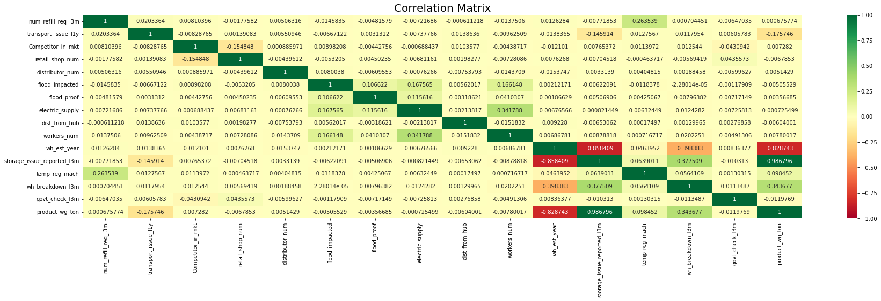
Correlation Matrix

Slide 6
Correlation Matrix
From the correlation matrix it is found that:
Target variable has a positive relationship with the following features:
1. refilling request received by the warehouse in last 3 months
2.number of competitor in the market
3. number of distributor who works between warehouse and retail shops,
4. storage issues reported by warehouse in last 3months(98%)
5. warehouse having temperature regulating machine indicator or not
5. number of times warehouse faces the breakdown in last 3 months(34%)
Target variable has a negative relationship with the following features
1. Number of transport issued for warehouse in last 1 year
2. Number of retail shop who sell noodles produced by the warehouse
3. Is warehouse is in flood impacted area or not
4. Warehouse is having flood proof indicator
5. Does the warehouse having proper electric supply along with some power backup
6. distance from the warehouse to production hub
7. no. workers in the warehouse
8. warehouse establishment year(82%)
9. govt_check_l3m

Slide 7
Difference from impacts suggested in M1
In milestone 1 refill request received in last 3 months , transport issued in last 1 year, competitor in market, number of retail shop, distance from hub, number of workers, and storage issue reported in last 3 months are said to have an impact on the target.
From the correlation matrix only storage issue reported in last 3 months has a high positive correlation(0.98) with target variable.
Only refill request received in last 3 months and competitor in market are having a weak positive correlation. The rest of them are having a negative correlation with the target.
In milestone 1 warehouse established year is said to have no impact on the target. But correlation matrix shows a high negative relationship between warehouse established year and target variable.

Slide 8
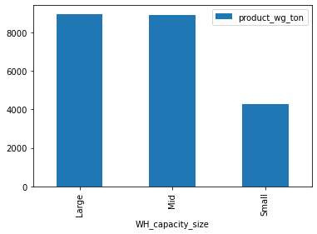
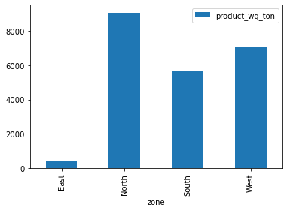
Bar Plot
Warehouse capacity vs Product Weight
From the bar plot it can be seen that there is no much variation among mid and large and thus it can be binned(clubbed)together.
Zone vs Product Weight

Slide 9
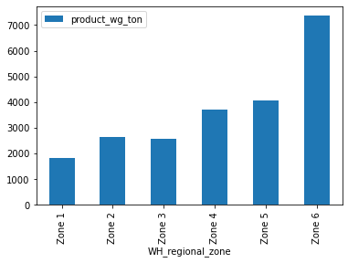
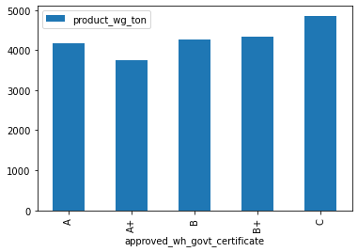
Bar Plot
Warehouse Regional Zone vs Product Weight
Type of Approval vs Product Weight

Slide 10
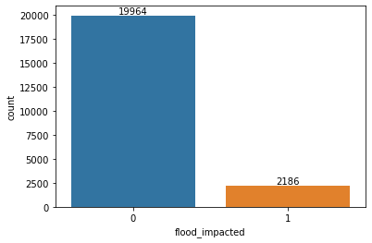
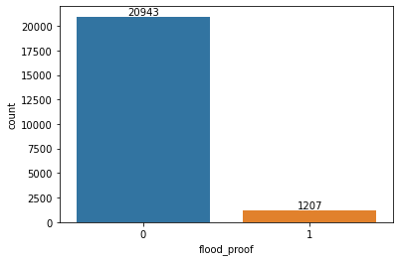
Count Plot
Flood Impacted
Flood Proof

Slide 11
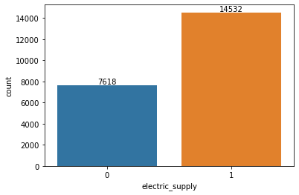
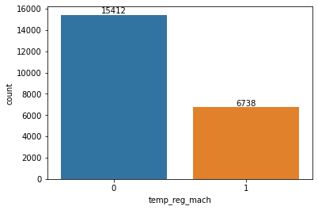
Count Plot
Electric Supply
Warehouse having temperature regulating machine or not

